Slide 1
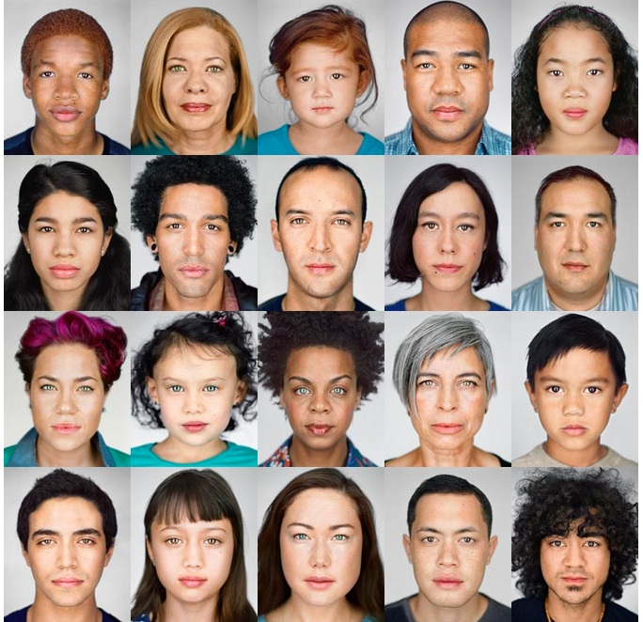
Race: the
Power of an Illusion

Slide 2
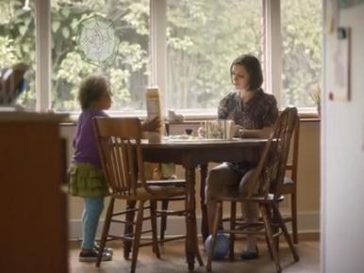
Why were some people upset by this Superbowl commercial?
http://www.youtube.com/watch?v=kYofm5d5Xdw
What did the real family have to say?
http://www.youtube.com/watch?v=kjJ4tqVV1OE

Slide 3
Ethnicity vs. Race
An ethnic group or ethnicity is a population of human beings whose members identify with each other, on the basis of a real or a presumed common genealogy or ancestry.
The term race refers to the concept of dividing people into populations or groups on the basis of various sets of physical characteristics (which usually result from genetic ancestry). Races are assumed to be distinguished by skin color, facial type, etc. However, the scientific basis of racial distinctions is very weak.

Slide 4
How does classifying people into “races” meet our three basic human emotional needs?
Feel safe?
Feel belonging?
Feel good about yourself?

Slide 5
What are some challenges of being “mixed race?”—real answers from teens
“Marking race on standardized tests”
“What are you?”
“Not belonging to a specific culture”
“Staying polite”
“Stereotyping”
“Jokes”
“acceptance”
“Confusion of self identity”
“You should be a model”

Slide 6
What are some positive to being mixed race?—real answers from teens
“Speaking two languages”
“Being a more curious person”
“Cultural immersion”
“Biological diversity=favorable?”
“2010 census found that multiracial youth
is the fastest growing youth group in the nation”

Slide 7
British Society
The British regard people of mixed race as the most attractive and successful, say psychologists.
Celebrities such as formula one champion Lewis Hamilton, footballer Ryan Giggs and X Factor star Leona Lewis have helped boost the image of mixed race people, according to a new study.
Psychological testing found they outstrip people who are white or black in terms of perceived attractiveness, with a rating that far exceeds their representation in British society.

Slide 8
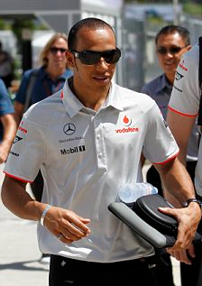
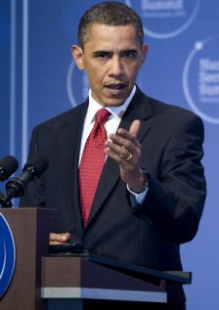
F1 racing car driver Lewis Hamilton (left) and President Obama (right) are just two examples of successful mixed-race men

Slide 9
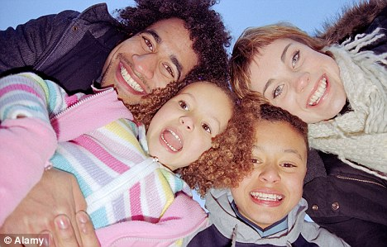
Mixed Race: Not just for Stars!

Slide 10
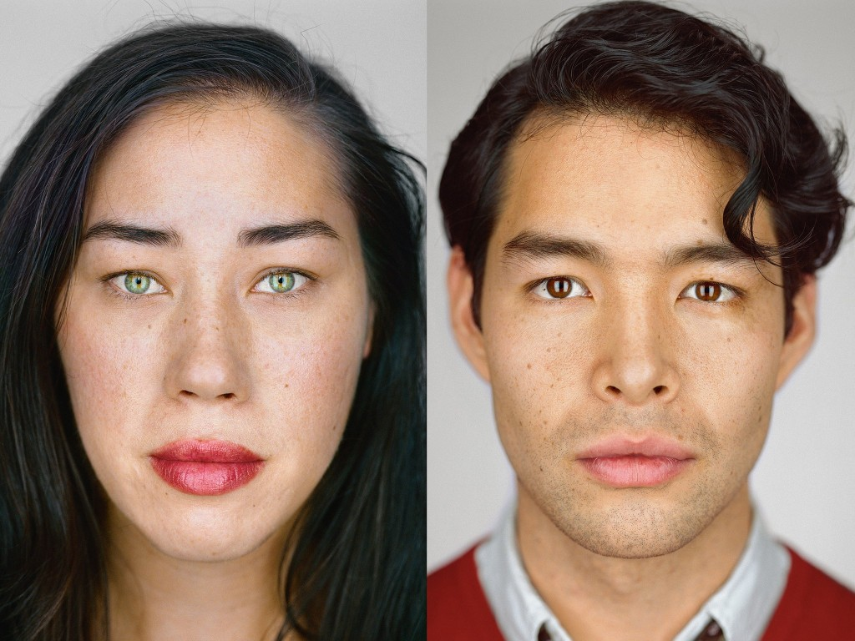
LEFT: Julie Weiss, 33, Hollywood, California | Self-ID: Filipino, Chinese, Spanish, Indian, Hungarian, and German Jew | Census boxes checked: white/Asian Indian/Chinese/Filipino RIGHT: Maximillian Sugiura, 29, Brooklyn, New York | Self-ID: Japanese, Jewish, and Ukrainian | Census boxes checked: white/Japanese

Slide 11
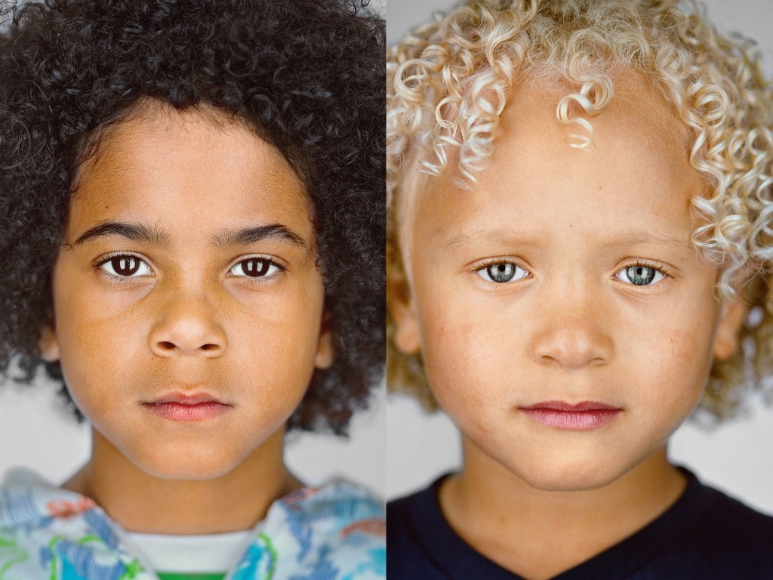
LEFT: Yoel Chac Bautista, 7, Castaic, California | Self-ID: black/Mexican/”Blaxican”| Census box checked: black. RIGHT: Tayden Burrell, 5, Sarasota, Florida | Self-ID: black and white/biracial | Census box checked: white/black

Slide 12
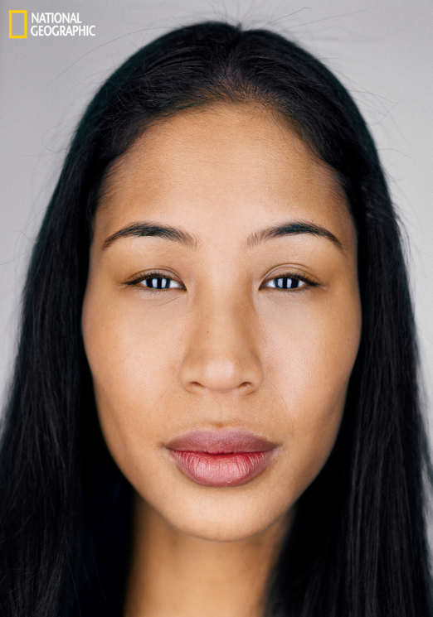
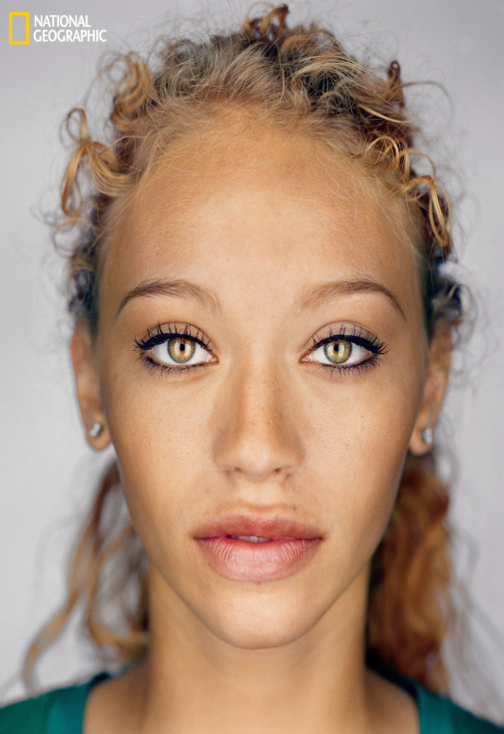
Celeste Seda, 26, Brooklyn, New York
Self-ID: Dominican and Korean
Census boxes checked: Asian/some other race
Jordan Spencer, 18, Grand Prairie, Texas
Self-ID: black/biracial
Census box checked: black

Slide 13
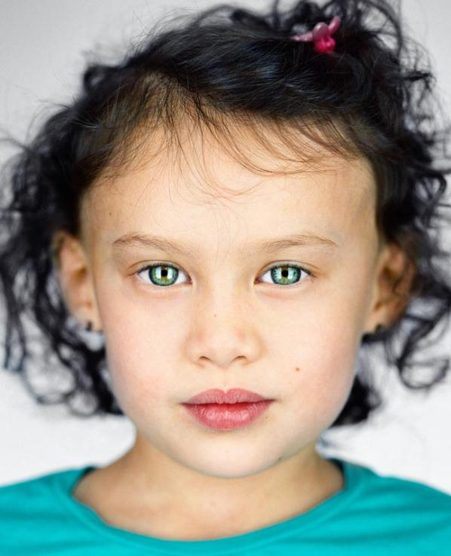
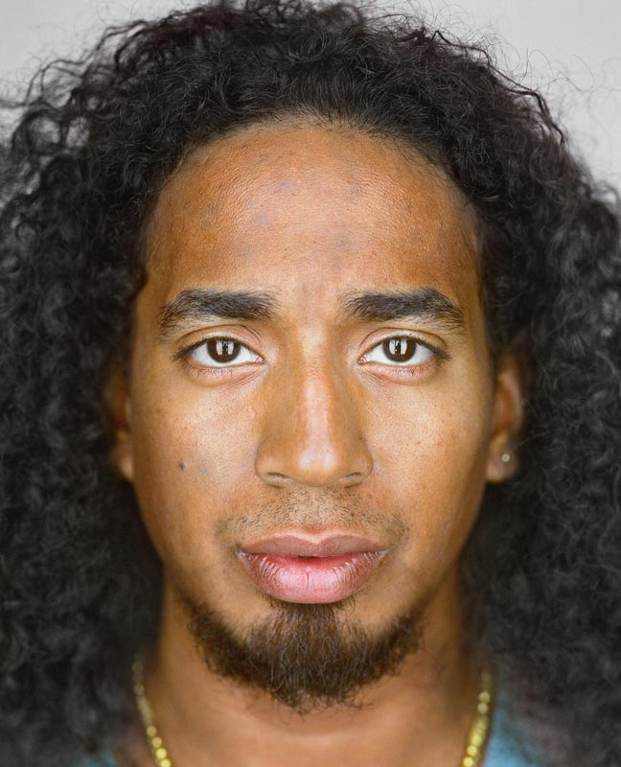
GABRIELA GUIZZO, 5, ROCKVILLE CENTRE, NEW YORK
SELF-ID: “A little of everything”
CENSUS BOXES CHECKED: white/Japanese
YUDAH HOLMAN, 29, LOS ANGELES, CALIFORNIA
SELF-ID: half Thai, half black
CENSUS BOXES CHECKED: other Asian

Slide 14
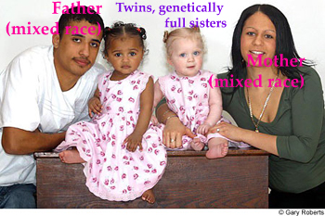
How can this occur?

Slide 15
Sonia Brown, left, with her boys Cameron, left, and Kyle and sister Sharon Harris and her girls Kayleigh and Paige, far right. A rare genetic fluke means they both have one child with light hair and pale skin and another with brown hair and darker skin

Slide 16
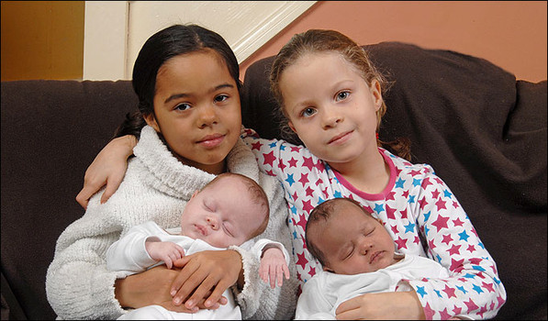
Spooner family gives birth to two sets of twins who appear to be different races. ...

Slide 17
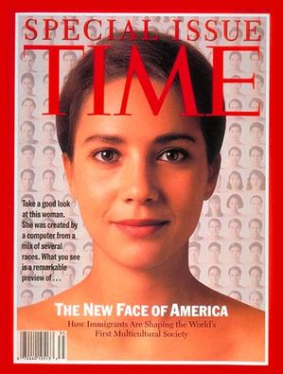

Slide 18
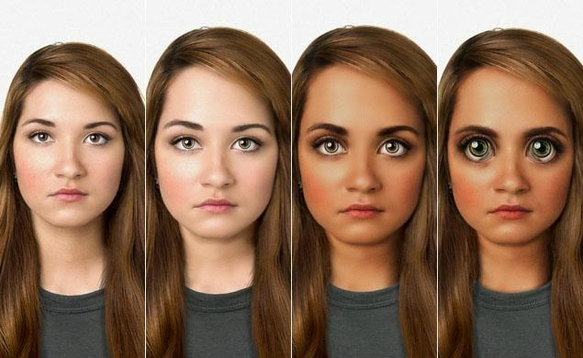
What will humans look like 100,000 years from now?

Slide 19
Dr. Alan Kwan, who holds a PhD in computational genomics from Washington University.
Kwan expects the human head to trend larger to accommodate a larger brain. Eyes will meanwhile get larger, as attempts to colonize Earth's solar system and beyond see people living in the dimmer environments of colonies further away from the Sun than Earth. Similarly, skin will become more pigmented to lesson the damage from harmful UV radiation outside of the Earth's protective ozone. Kwan expects people to have thicker eyelids and a more pronounced superciliary arch (the smooth, frontal bone of the skull under the brow), to deal with the effects of low gravity.
The remaining 40,000 years, or 100,000 years from now, Kwan believes the human face will reflect "total mastery over human morphological genetics. This human face will be heavily biased towards features that humans find fundamentally appealing: strong, regal lines, straight nose, intense eyes, and placement of facial features that adhere to the golden ratio and left/right perfect symmetry," he says.
Eyes will seem "unnervingly large" -- as least from our viewpoint today -- and will feature eye-shine and even a sideways blink from the re-introduced plica semilunaris to further protect from cosmic ray effects. There will be other functional necessities: larger nostrils for easier breathing in off-planet environments, denser hair to contain heat loss from a larger head -- features which people may have to weigh up against their tastes for what's genetically trendy at the time. Instead of just debating what to name a child as new parents do today, they might also have to decide if they want their children to carry the most natural expression of a couple's DNA, such as their eye-color, teeth and other features they can genetically alter.

