Slide 1
Roots Group 12 & 13
Stereo, scope, thermo, gyro, son, corp, sangui, amat

Slide 2
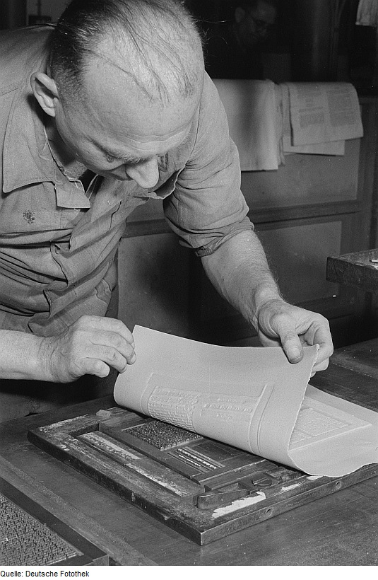
Stereo = solid
Stereotype- "printed by means of a solid plate,
from Greek stereos ‘solid’”
Stereophonic- In sound recording and reproduction when using two or more channels of transmission are put together so that the reproduced sound seems to surround the listener and to come from more than one source.

Slide 3
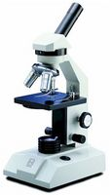
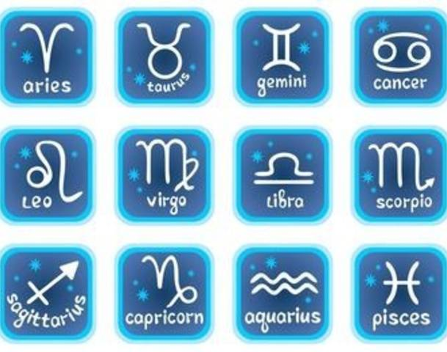
scope = watch & See
Microscope- an instrument used for viewing very small objects, typically magnified several hundred times.
Horoscope-a forecast of a person's future, based on the positions of the stars and planets at the time of that person's birth.

Slide 4
Thermo= heat
Thermostat
hypothermia
a device that automatically regulates temperature, or that activates a device when the temperature reaches a certain point.
the condition of having an abnormally low body temperature, typically one that is dangerously low

Slide 5
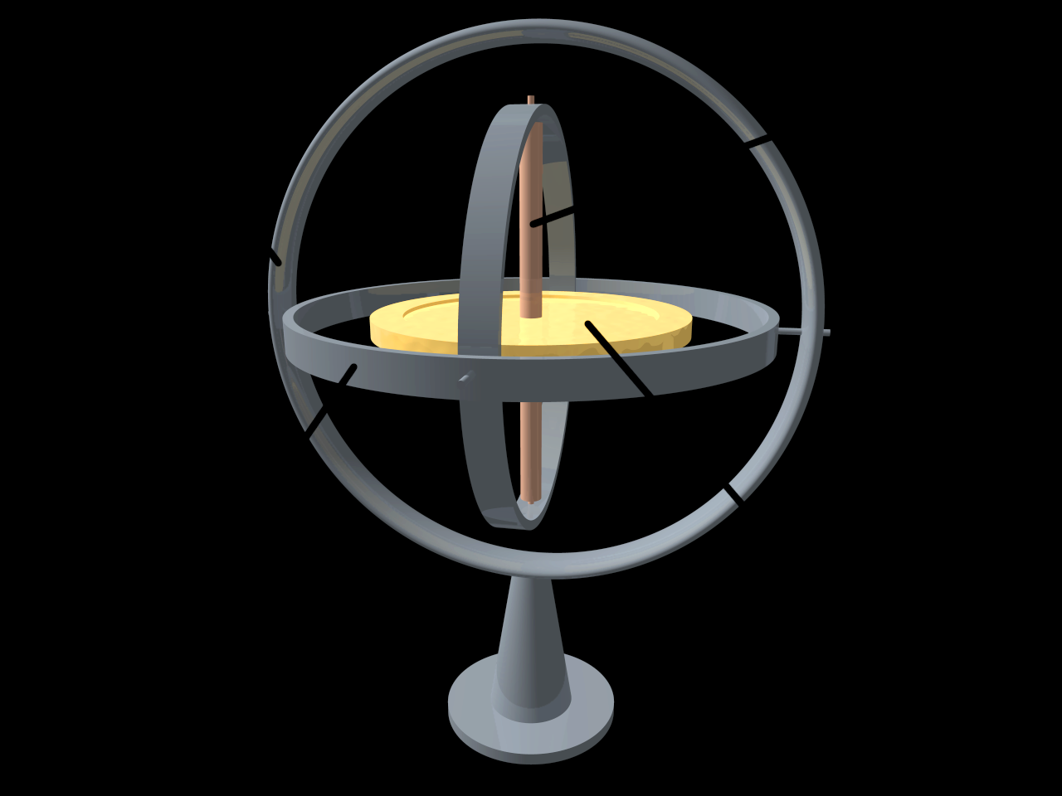
Gyro = Bend, curve, turn
Gyration-a rapid movement in a circle or spiral; a whirling motion.
Gyroscope- a device consisting of a wheel or disk mounted so that it can spin rapidly about an axis to provide stability or maintain a reference direction in navigation systems, automatic pilots, and stabilizers.

Slide 6
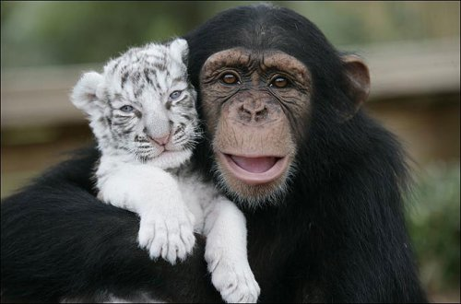
Amateur- engaging or engaged in without payment; nonprofessional
Amiable-having or displaying a friendly and pleasant manner.
Amat = love

Slide 7
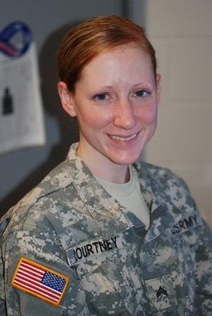
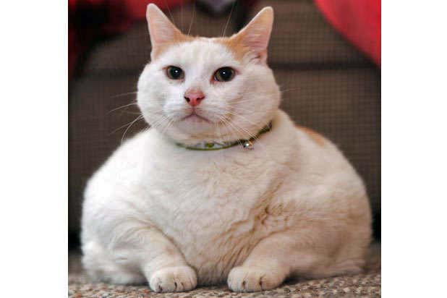
Corp = body
Corporal
a low-ranking noncommissioned officer in the armed forces, in particular (in the US Army)
Corpulent
overweight

Slide 8
Sangui = Blood
Sangria-a beverage from Spain and Portugal that consists of wine, chopped fruit, a sweetener, and a small amount of added brandy.
Sanguine-
optimistic or positive, especially in an apparently bad or difficult situation
a blood-red color.
Sanguinary-involving or causing much bloodshed.

Slide 9
Son = sound
Unison- sounds uttered simultaneously.
Sonnet-a poem with fourteen lines using formal rhyme schemes, typically with ten syllables per line.

