Slide 1
Roots Group 1 & 2
ion/ism/vita/chron/phobia
Notes:
*

Slide 2
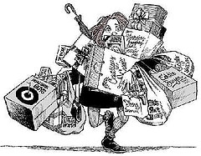
#1 Noun Makers!
-ism (a belief/ doctrine)
Pacifism-
A belief in peace
Materialism
A belief that the things you own define
who you are
Fatalism-
A belief that you are not in control of your destiny
Notes:
*

Slide 3
-ism continued…
Optimism =) a positive outlook- glass is half full
Pessimism =( a negative outlook- glass is half empty
Atheism- a belief that there is no God
Nihilism- a belief in nothing. We are meaningless beings

Slide 4
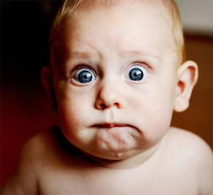
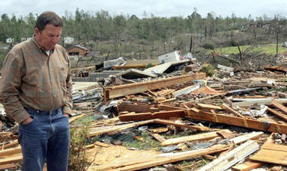
#1 Noun Makers!
tion (state of being)
Completion- state of being complete or finished
Reaction-an action performed or a feeling experienced in response to a situation or event
Transition- moving from one thing to the next.
Devastation- great destruction or damage. Overwhelming shock or grief.

Slide 5
#2 Vita - Life
Vitamin- a substance needed for a healthy life
Vitality- a lively quality
Vital-necessary to live
Revitalize- to give new life to something
Viable- capable of living

Slide 6
#2 Chron-Time
Chronological- putting events in order of time.
Chronology- The order in which a series of events happens
Synchronize- To happen at the same time
Chronic- Occurring time and time again!
Anachronism- something that is out of time order (in the wrong time)

Slide 7
#2 Phobia- fear
Claustrophobia- fear of small spaces
Acrophobia- fear of heights
Xenophobia- fear of foreigners
Hydrophobia- fear of water
Agoraphobia- fear of public places

