Slide 1
The Colon: Why We Learn It!

Slide 3
Use a colon (:) to introduce a list or series of items after a complete sentence.
New Zealand is free of many medical issues: heart worm disease, most ticks and rabies.
Deceased bodies still have functions: nail growth, digestion and muscle movement.
X

Slide 4
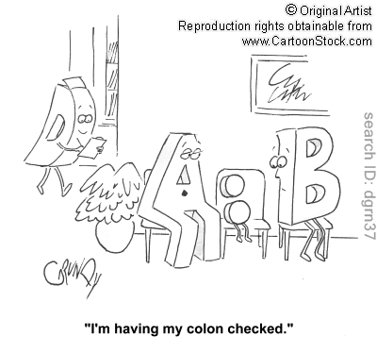
Some Incorrect Uses of Colons

Slide 5
Some Incorrect Uses of the Colon (no verbs or prepositions before the colon)—Remember sentence before colon must be an independent clause.
Some of the first foods eaten in outer space were: applesauce, beef-vegetable mixture and peaches.
The United States has several fast food restaurant chains that date back to the 1920s including: White Castle, 7-Eleven, and Kentucky Fried Chicken.

Slide 6
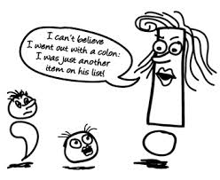

Slide 7
Use a colon to connect two complete sentences that are very closely linked. Capitalize the first word after the colon.
Most snowflakes form with 6 tips: The colder it is when the snowflake is formed the more defined the tips will be.
The Mona Lisa is missing some important features: She doesn’t have eyelashes or eyebrows.

Slide 8
Use a colon to signal a name or description at the end of a sentence when you want to put a lot of emphasis on that name or description.
There is an active ingredient in toothpaste that can be lethal to children: sodium fluoride.
Buttermilk contains lemon juice, milk and white vinegar, but is missing one interesting ingredient: butter.
Many people who read the word yawn do something interesting: yawn themselves!
Do you think the portion after the colon should be capitalized in these cases? Why or why not?

Slide 9
Other uses of the colon (clean)
Time
12:15
Formal business letter greeting
Dear Sir or Madam:
In a play to notate who is speaking
BIFF: He had the wrong dreams. All, all, wrong. HAPPY (almost ready to fight Biff): Don't say that! BIFF: He never knew who he was.

Slide 10
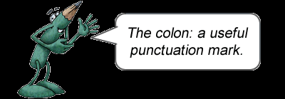
What you have probably learned (kidding!)

