Slide 1
The Rise of Hatred

Slide 2
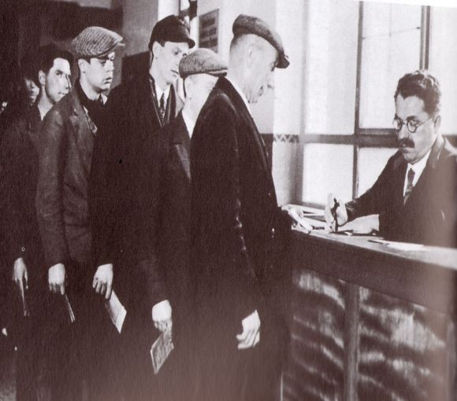
1929- Great Depression

Slide 3
The Impact on Germany
The impact [in areas of Germany] was even more dire. Germans were not so much reliant on exports as they were on American loans, which had been propping up the economy since 1924. No further loans were issued from late 1929, while American financiers began to call in existing loans.
Despite its rapid growth, the German economy was not equipped for this retraction of cash and capital. Banks struggled to provide money and credit; in 1931 several Banks folded.
In 1930 the US, the largest purchaser of German industrial exports, put up tariff barriers to protect its own companies. German industrialists lost access to US markets and found credit almost impossible to obtain. Many industrial companies and factories either closed or shrank dramatically.
By 1932 German industrial production was at 58 percent of its 1928 levels. The effect of this decline was spiraling unemployment. By the end of 1929 around 1.5 million Germans were out of work; within a year this figure had more than doubled. By early 1933 unemployment in Germany had reached a staggering six million.
The effects this unemployment had on German society were devastating.
http://alphahistory.com/weimargermany/great-depression/#sthash.3QZtS81v.dpuf

Slide 4
Adolf Hitler, age 35, on his release from Landesberg Prison, on December 20, 1924. Hitler had been convicted of treason for his role in an attempted coup in 1923 called the Beer Hall Putsch. This photograph was taken shortly after he finished dictating "Mein Kampf" to deputy Rudolf Hess. Eight years later, Hitler would be sworn in as Chancellor of Germany, in 1933. (Library of Congress)

Slide 5
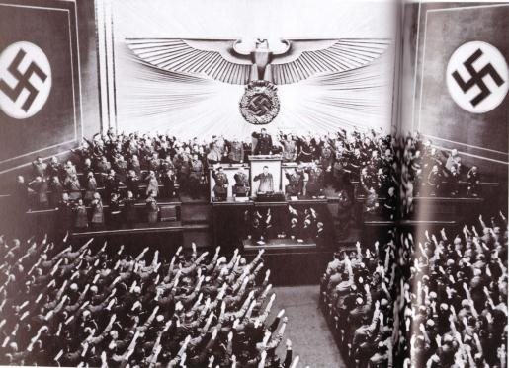
He was a gifted speaker…

Slide 6
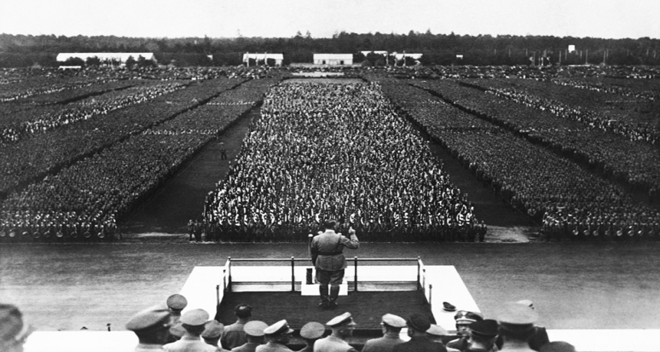
And people were looking for change and hope…
Hitler promised this…

Slide 7
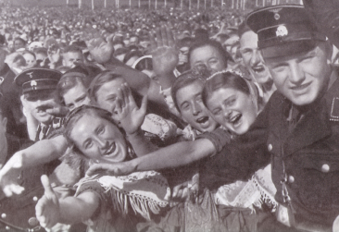
And people listened…
Especially the youth:

Slide 8
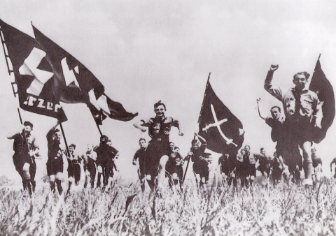
This was his plan all along.

Slide 9
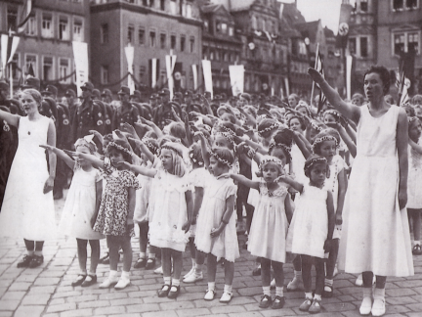
From a very young age they were taught “right from wrong”

Slide 11
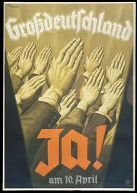
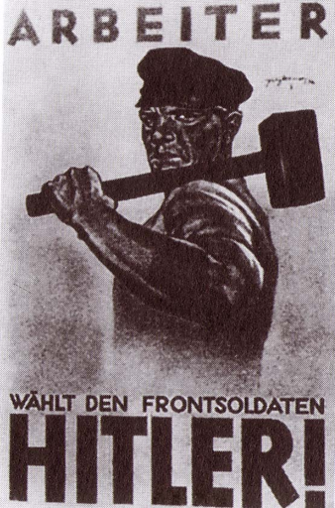
He promised to put Germany back to work:

Slide 12
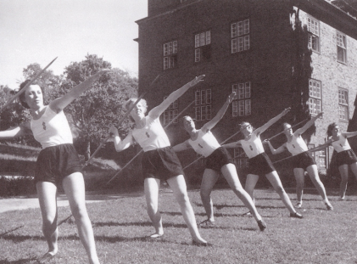
He promoted a healthy lifestyle, athletics and purity.

Slide 13
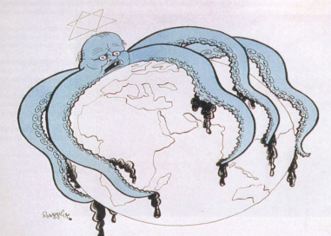
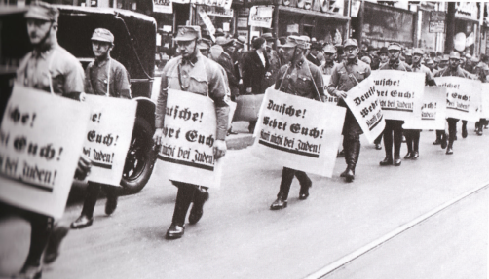
But this all came at a price.

Slide 14
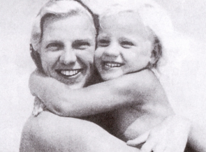
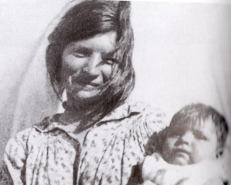
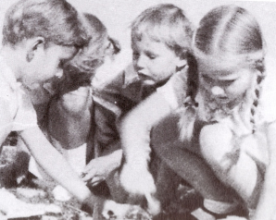
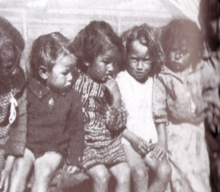
Groups were singled out as inferior and impure.

Slide 15
Anti-semitism became a national policy.
Jews were made fun of and threatened at public events.

Slide 16
In 1935 persecution became law.
At the annual party rally held in Nuremberg in 1935, the Nazis announced new laws which institutionalized many of the racial theories prevalent in Nazi ideology. The laws excluded German Jews from Reich citizenship and prohibited them from marrying or having sexual relations with persons of "German or related blood." Ancillary ordinances to the laws disenfranchised Jews and deprived them of most political rights

Slide 17
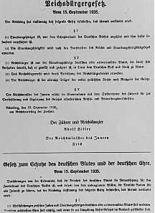
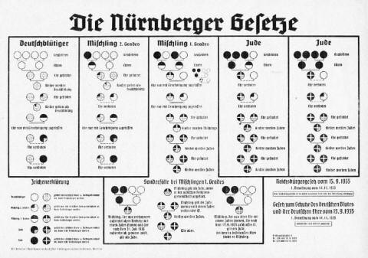

Slide 18
“After the Olympic Games (in which the Nazis did not allow German Jewish athletes to participate), the Nazis again stepped up the persecution of German Jews. In 1937 and 1938, the government set out to impoverish Jews by requiring them to register their property and then by "Aryanizing" Jewish businesses. This meant that Jewish workers and managers were dismissed, and the ownership of most Jewish businesses was taken over by non-Jewish Germans who bought them at bargain prices fixed by Nazis. Jewish doctors were forbidden to treat non-Jews, and Jewish lawyers were not permitted to practice law.” -USHMM

Slide 19
America's Jesse Owens, center, salutes during the presentation of his gold medal for the long jump on August 11, 1936, after defeating Nazi Germany's Lutz Long, right, during the 1936 Summer Olympics in Berlin. Naoto Tajima of Japan, left, placed third. Owens triumphed in the track and field competition by winning four gold medals in the 100-meter and 200-meter dashes, long jump and 400-meter relay. He was the first athlete to win four gold medals at a single Olympic Games. (AP Photo)

Slide 20
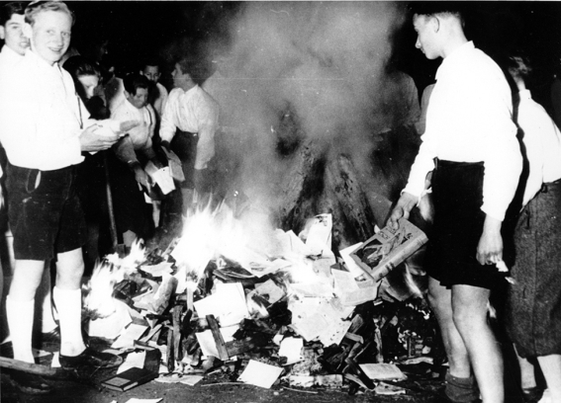
Books were burned…
Members of the Nazi Youth participate in burning books, Buecherverbrennung, in Salzburg, Austria, on April 30, 1938.
The public burning of books that were condemned as un-German, or Jewish-Marxist was a common activity in Nazi Germany. (AP Photo)

Slide 21
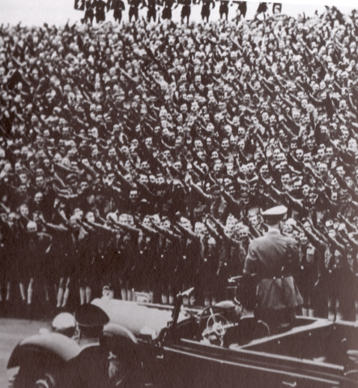
And things continued to progress…

Slide 22
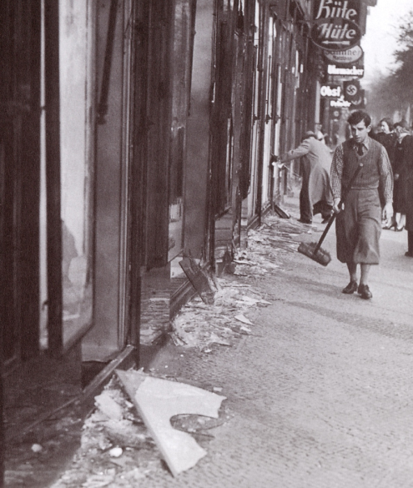
Kristallnacht- November 10th, 1938

Slide 23
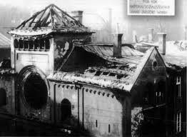
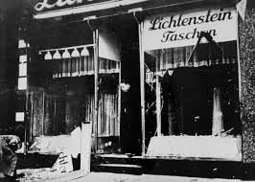

Slide 24
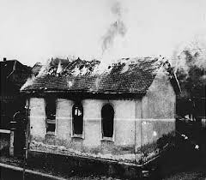
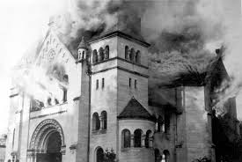
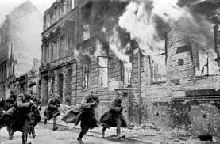
“The Night of Broken Glass”

